Slide 1
Lecture #4
Data collection (2/2): Web scrapping

Slide 2
Introduction
Most common method
3 methods :
Human method
API
Scrapping

Slide 3
Reminder
Like any other web data, be aware of copyrights, trademarks, intellectual properties, …
Consult the law, the website owner, … according to your objective (publishing data, …)

Slide 4
Introduction
API is for Application Programming Interface
Interface between machines
Operating systems or web API
Many shapes and forms:
Turning off/on lights
Liking pictures on Instagram
…

Slide 5
Introduction
All working the same way:
you make a request
you get a answer (with requested things)
This is calling an API

Slide 6
Python
The main library: “requests”

Slide 7
Let’s try
Website: randomuser.me
Make a call to the API with Python
Check the text of the result

Slide 8
URLS
URL is the main information required for API
Contain most of the time “api”
Some famous API url:
https://api.twitter.com
https://api.github.com
https://api.stripe.com
Needs credentials

Slide 9
Another example
TheDogAPI (or ‘https://api.thedogapi.com/’ to directly access to the API)
Documentation: https://docs.thedogapi.com/
Let’s try it

Slide 10
TheDogApi: base and endpoint
The base is https://api.thedogapi.com/
Endpoint: part of the URL that specify what you want
Check documentation: https://docs.thedogapi.com/
Get the breeds list with endpoint

Slide 11
Don’t worry: TheCatApi exists
The base is "https://api.thecatapi.com/”

Slide 12
Information about requests
Use response.request to get the sended request
.url: to get the used url
.path_url: to get the endpoint
.method: to get the method
.headers: to get the headers

Slide 13
Information about the response
.text: to get the text of the response
.status_code: to get the status (200 : success, 404 : not found)
.reason: to get the message with the status code
.headers: to get the headers of the response

Slide 14
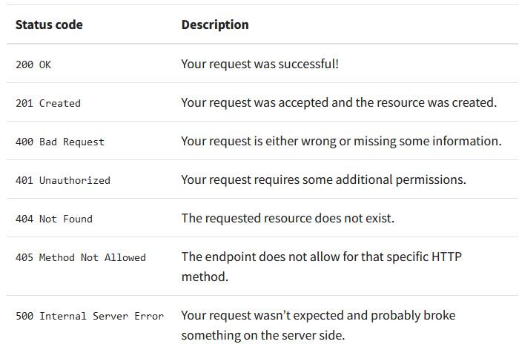
The status

Slide 15
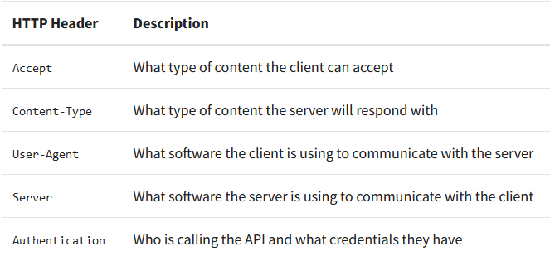
The headers

Slide 16
Headers
Response.headers
response.request.headers

Slide 17
Custom headers
Dictionary
Option of the get method
Content-Type give the information about the content of the response
Let’s check with cat images

Slide 18
The response method
.text
.content
.json()

Slide 19
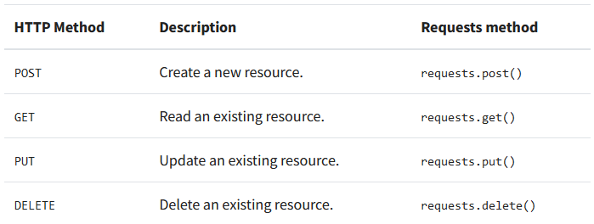
The HTTP methods
Let’s try them !

Slide 20
The query parameters
To specify parameter in your API call
Come after the URL and the Endpoint.
Ex: https://www.google.com/search?q=Hello
BASE
Endpoint
Query parameter

Slide 21
The query parameters
Use ‘?’ to separate endpoint and a query parameters
Use ‘&’ to separate several query parameters
Ex : https://www.youtube.com/results?search_query=python+api&sp=CAISAhAB

Slide 22
Example
With randomuser.me
Use the query parameter gender to specify you request

Slide 23
Query parameters with dictionary
Create the dictionary
Use the option “params” in the get method

Slide 24
Authentication
Some APIs require authentication
Return 401 Unauthorized or 403 Forbidden
API keys or basics authentication
More complex if possible
Make the website able to follow how many request you make and manage it

Slide 25
API keys
Personal
Let’s try with NASA
The demo key is “DEMO_KEY”
Normally you find API key after signing up

Slide 26
Let’s try with stock market !
www.polygon.io
API to get stock market prices

